Slide 1
Impact in the Research Excellence Framework (REF)
Follow us on Twitter
@REF_2021
Email REF: info@ref.ac.uk
Graeme Rosenberg
Head of TEF at the Office for Students
Former REF Manager at the Higher Education Funding Council for England

Slide 2
The UK research funding system
Dual support funding of UK research (UK Research and Innovation)
Block grant funding (Research England)
Allocated through a periodic REF exercise
Grant funded research (Research Councils)
Research grant applications

Slide 3
What is the REF?
UK’s system for assessing the excellence and impact of research by UK higher education institutions
First carried out in 2014, replacing the previous Research Assessment Exercise
It is a process of expert review, carried out by expert panels for each of 34 subject-based units of assessment (UOAs), under the guidance of four main panels
For each submission, three distinct elements are assessed: the quality of outputs, their impact beyond academia, and the environment that supports research

Slide 4
Who runs the REF?
The REF is undertaken by the four UK higher education funding bodies:
The funding bodies’ shared policy aim for research assessment is to secure the continuation of a world-class, dynamic and responsive research base across the full academic spectrum within UK higher education

Slide 5
What is the purpose of the REF?
Accountability
To provide accountability for public investment in research and produce evidence of the benefits of this investment
Reputation
To provide benchmarking information and establish reputational yardsticks, for use within the HE sector and for public information
Funding
To inform the selective allocation of funding for research
Ca £2bn p.a.

Slide 6
Background: UK research assessment
Research Selectivity Exercises in 1986 and 1989
Research Excellence Framework 2014
Research Assessment Exercises in 1992, 1996, 2001 and 2008
Notes:
RSEs
The first UK-wide research quality assessments
Assessed departments not universities
Assessment of statistics on research outputs and income, limited reading of research papers: more emphasis on volume than quality
1989 results partly used in funding allocations
RAEs
UK-wide (England, Scotland, Wales, N. Ireland)
Peer review of ‘departments’
Carried out by ~70 subject-based panels
Assessed the quality of outputs, environment and esteem
Publication of submissions and results
Gradually became more sophisticated, evolving through dialogue with the sector

Slide 7
The introduction of impact in 2014
A scoping study, pilot exercise and consultation explored:
How to define (non-academic) impact?
How can impact be evidenced and evaluated?
How to address key challenges of attribution and time lags?
How much weight should impact carry in the overall REF results?

Slide 8
Quick Quiz!
What’s the basic method for assessing impact in the REF?
What’s the weighting of impact in the overall REF results?

Slide 9
Assessing impact in the REF
Key principles were established:
A broad definition of impact
A case study approach with diverse forms of evidence
Contribution not attribution
Peer judgement
Significant weight
Impact was first assessed in REF2014
The approach has been refined for REF2021

Slide 10
Definition of impact
an effect on, change or benefit to the economy, society, culture, public policy or services, health, the environment or quality of life, beyond academia

Slide 11
Impact case studies
Examples of the strongest impacts arising from the submitting unit’s research
Four page documents setting out:
Details of the underpinning research
Explanation of how it contributed to the impact
Explanation of the impact and evidence of its ‘reach and significance’
Sources of corroboration

Slide 12
Impact case studies
For REF2021:
Impacts must occur during period 2013 to 2020
The underpinning research must be high quality, and carried out since 2000.
Number of case studies required relates to overall number of staff submitted – but not all staff expected to be included in case studies

Slide 13
Impact – underpinning research
The impact described in a case study must have been:
…underpinned by…
Research made a distinct and material contribution to the impact
…excellent research…
Research as a whole is at least equivalent to two star
…produced by the submitting unit, 1 Jan 2000-31 Dec 2020
Staff carried out research while working in the submitting HEI

Slide 14
Contribution not attribution
The research must have made a distinct and material contribution to the impact. We do not attempt to apportion how much of the impact was ‘caused’ by the research.
What are the routes through which research can contribute to a change or benefit to society?

Slide 15
Contribution not attribution
The research must have made a distinct and material contribution to the impact. We do not attempt to apportion how much of the impact was ‘caused’ by the research.
What are the routes through which research can contribute to a change or benefit to society?
Direct or indirect influence
Intended or serendipitous
Single output or large body of knowledge
Through public engagement, expert advice, etc.
Exploitation by the institution or by third parties

Slide 16
Case study assessment
Assessed by both academics and research users on the REF panels
Rated on a four-point scale
Reach
the extent and/or diversity of the beneficiaries of the impact, as relevant to the nature of the impact.
Significance
the degree to which the impact has enabled, enriched, influenced, informed or changed the performance, policies, practices, products, services, understanding, awareness or well-being of the beneficiaries.

Slide 17
Evidence of impact
Who or what has benefited or been impacted on?
How have they benefitted or been impacted on?
What kinds of evidence can demonstrate this?

Slide 18
Submission requirements
Number of case studies determined by FTE of staff submitted.
Category A submitted staff (FTE) | Required number of case studies
Up to 19.99 | 2
20-34.99 | 3
35-49.99 | 4
50-64.99 | 5
65-79.99 | 6
80-94.99 | 7
95-109.99 | 8
110-159.99 | 9
160 or more | 10, plus 1 further case study per additional 50 FTE
Notes:
Minimum of two case studies.

Slide 19
Weighting of impact
Overall quality
FTE x 2.5 = number of outputs required
Impact case studies
Environment data and template
Outputs
Impact
Environment
60%
25%
15%
Notes:
-

Slide 20
Units of assessment
Main Panel B
7. Earth Systems and Environmental Sciences
8. Chemistry
9. Physics
10. Mathematical Sciences
11. Computer Science and Informatics
12. Engineering
Main Panel C
13. Architecture, Built Environment and Planning
14. Geography and Environmental Studies
15. Archaeology
16. Economics and Econometrics
17. Business and Management Studies
18. Law
19. Politics and International Studies
20. Social Work and Social Policy
21. Sociology
22. Anthropology and Development Studies
23. Education
24. Sport and Exercise Sciences, Leisure and Tourism
Main Panel D
25. Area Studies
26. Modern Languages and Linguistics
27. English Language and Literature
28. History
29. Classics
30. Philosophy
31. Theology and Religious Studies
32. Art and Design: History, Practice and Theory
33. Music, Drama, Dance, Performing Arts, Film and Screen Studies
34. Communication, Cultural and Media Studies, Library and Information Management
Main Panel A
1. Clinical Medicine
2. Public Health, Health Services and Primary Care
3. Allied Health Professions, Dentistry, Nursing and Pharmacy
4. Psychology, Psychiatry and Neuroscience
5. Biological Sciences
6. Agriculture, Food Veterinary and Sciences
Notes:
-

Slide 21
Impacts submitted in 2014
How many case studies were submitted to REF 2014?
6,975
What percentage of case studies were judged ‘outstanding’ (4*)?
44%
How many countries were mentioned in case studies in 2014?
205

Slide 22
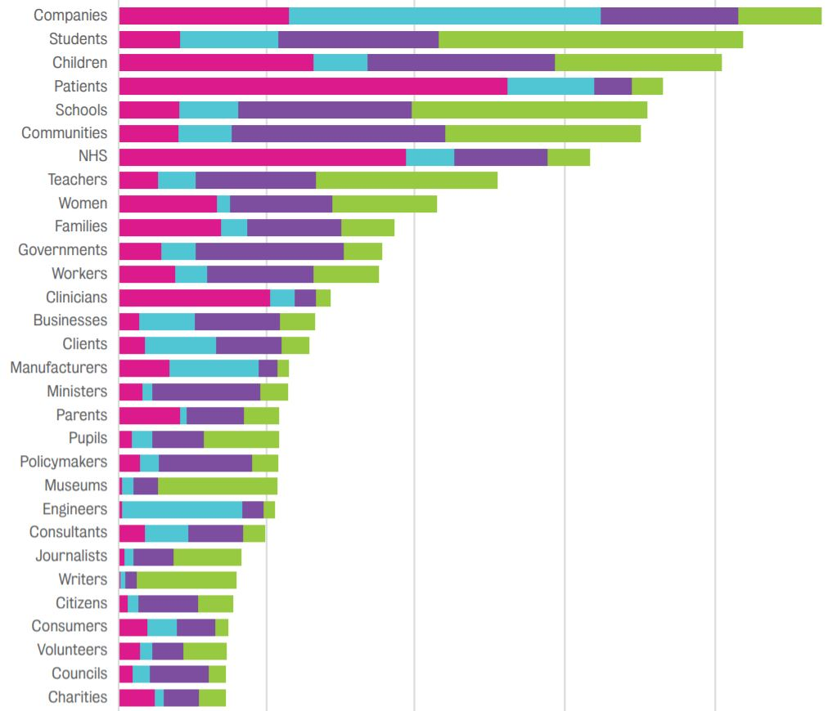
Beneficiaries cited in case studies

Slide 23
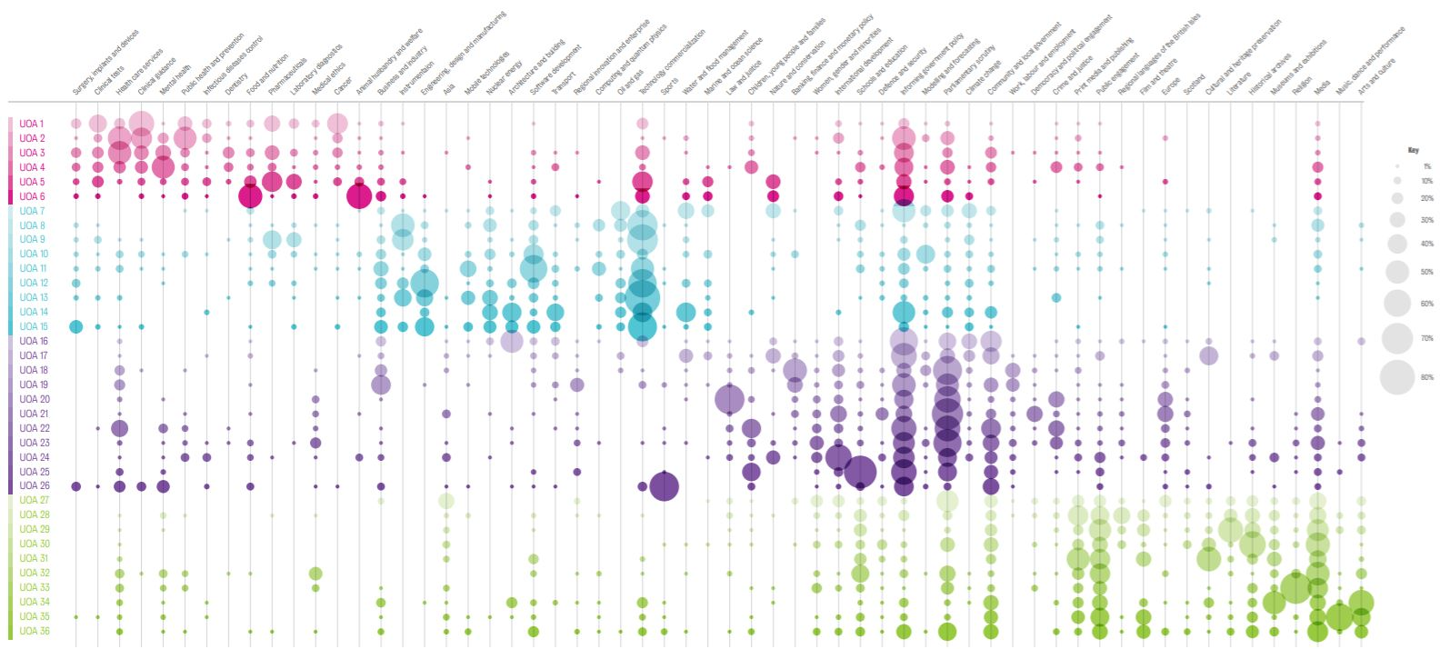
Impacts submitted in 2014

Slide 24
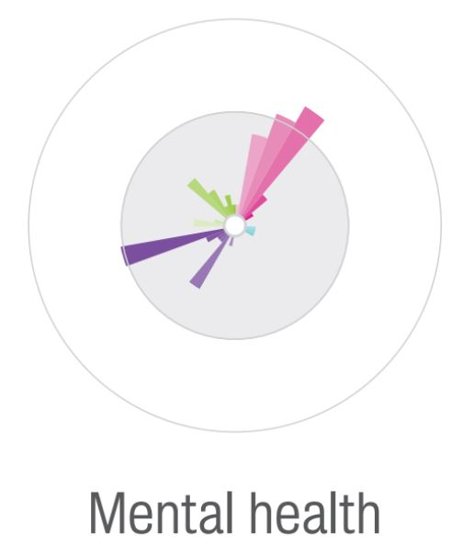
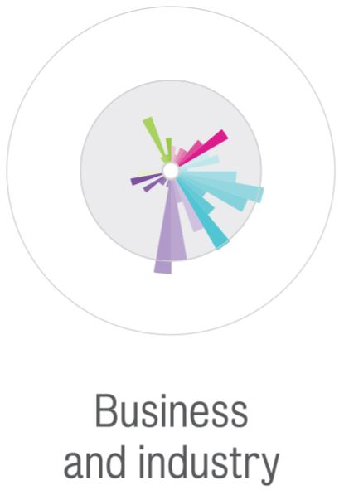
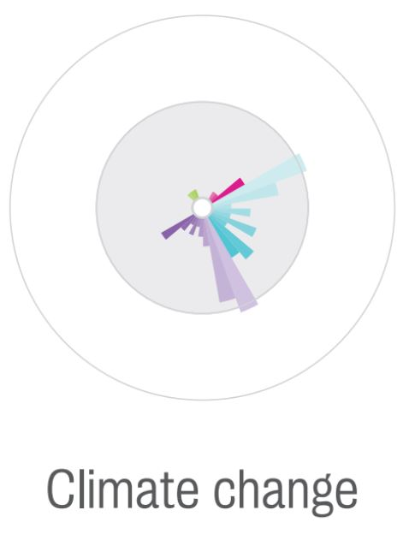
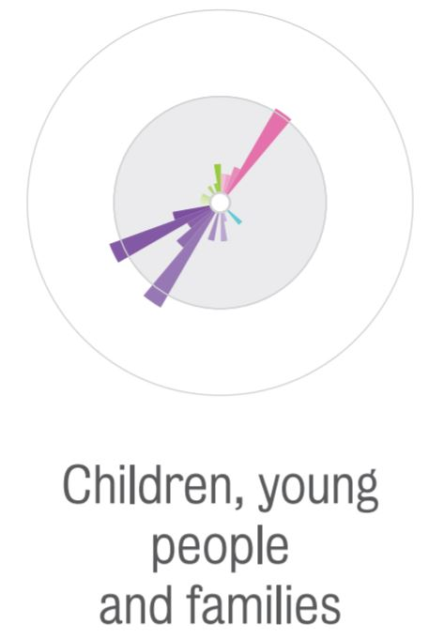
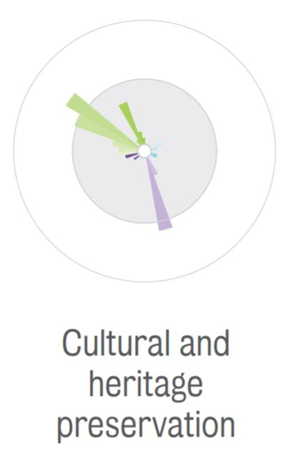
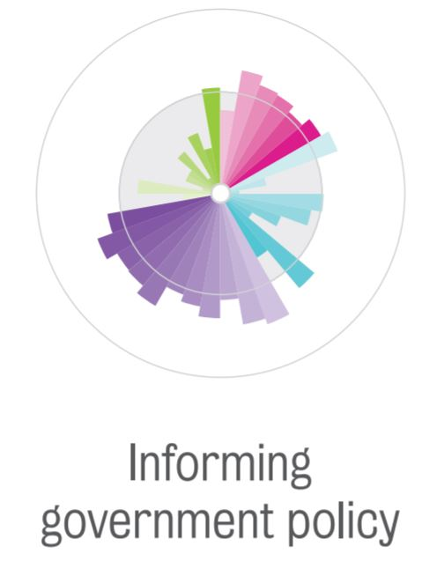
Impact wheels

Slide 25
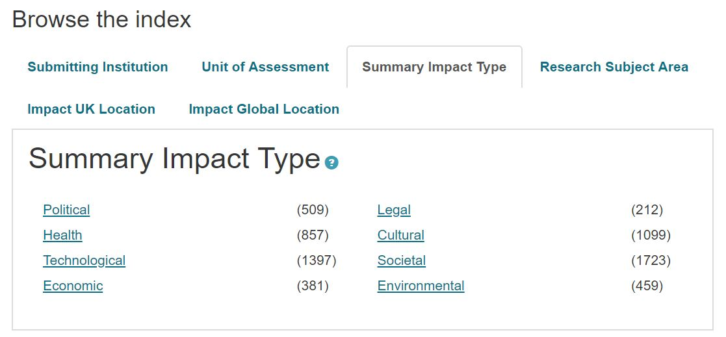
Impact database
A searchable database is available: https://impact.ref.ac.uk/casestudies/

Slide 26
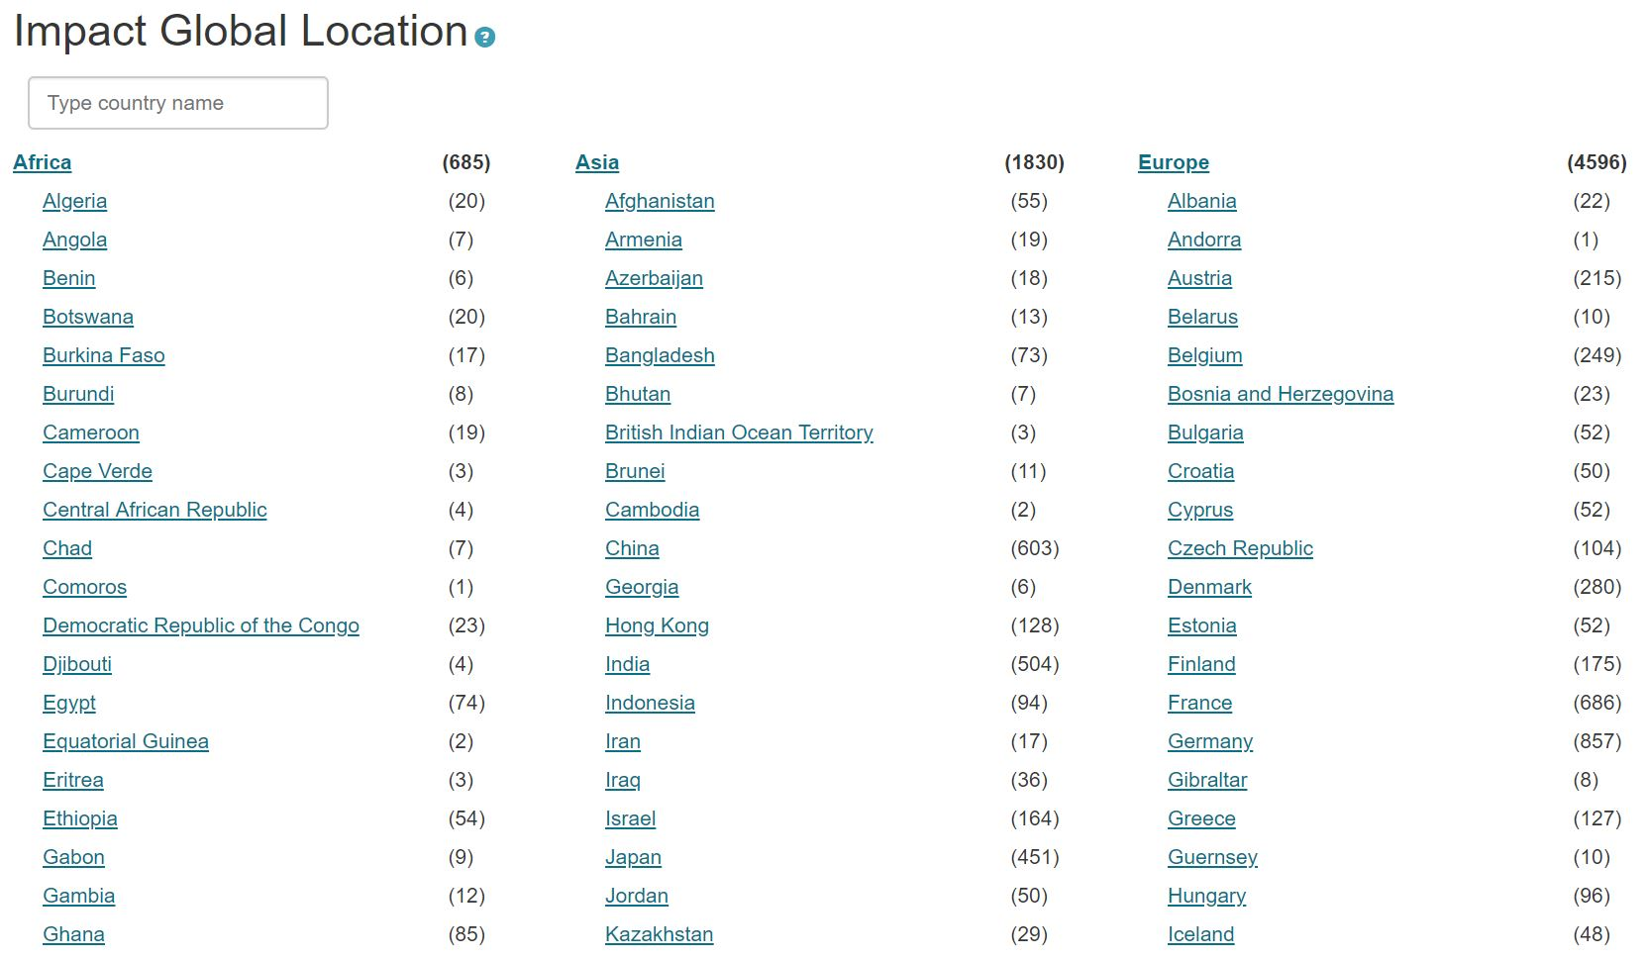
Impact database

Slide 27
Questions

Slide 28
Interactive Exercise

Slide 29
What makes a strong case study?
Panel overview reports from 2014:
High-scoring
Clear and compelling narrative
Low-scoring
Lack of objective evidence
Verifiable evidence of reach and significance
Evidence of unit’s contribution to research
Superficial impacts
Self-contained
Explicit links between research and claimed impact
Vague description of impacts and/or their relationship to the research
Distinguishes between dissemination and impact
Focus on dissemination without explaining outcomes (‘so what?’)
Clearly identified beneficiaries

Slide 30
Examples of impact
Some examples follow, drawn from those coded as ‘societal’ and having an impact in Belgium
For each example, discuss:
Is it clear who the beneficiaries are? (reach)
Is it clear how they benefited? (significance)
What further evidence is needed?

Slide 31
Example 1
In My Shoes: A Software Tool for Professionals assisting Children and Vulnerable Adults
Summary of the impact
This case describes social and health impact which arose as a result of interdisciplinary research at the University of Liverpool and the University of Manchester on the use of computer tools for communication with children and vulnerable adults. This research led to the development of the In My Shoes (IMS) computer program which is now widely used for interviewing children (for example in cases of child abuse) in local authorities across the UK. Since 2008, IMS has been used in the UK by more than 750 practitioners including psychologists, child psychiatrists, other mental health staff, health workers, educational workers, and specialists in forensic services. IMS is also used internationally in Ireland, Belgium, Sweden, and Norway, where more than 100 practitioners are already trained and are using the program in their day to day work.

Slide 32
Example 2
Assisting trafficked persons and exploited migrants to access their human rights
Summary of the impact
Trafficked persons have benefitted directly from van den Anker's research at UWE through improved support and legislation. Her policy model on human trafficking prevention assisted changes in the UK, Ireland, Portugal, Czech Republic, Belgium and Sweden and informed local policy development through her training of politicians, civil servants and NGOs in Bristol, Birmingham and Wales. Increased multi-agency working promoted by van den Anker has led to the establishment of new support services like a safe house and the Migrant Rights Centre in Bristol, directly benefiting migrants. International dissemination contributed to agenda changes in international organisations such as the Organization for Security and Co-operation in Europe.

Slide 33
Example 3
The Impact of the Internet on Parliamentary Public Engagement
Summary of the impact
This case study focuses on the impact of the UoA's research on parliamentary public engagement, particularly the body of research on the use of internet-based tools by parliaments, produced by Leston-Bandeira within the Centre for Legislative Studies, This research has been disseminated through national and international `insider' practitioner networks, with the research having both direct and indirect impacts on the way certain parliaments have used these tools to communicate and engage with citizens. This body of research has led parliaments to amend their policies and practice relating to the management and support of web-based tools.

Slide 34
Example 4
Reducing social exclusion through participation in tourism
Summary of the impact
Research at the University of Surrey, has assisted disabled people and low-income groups to access tourism, a significant non-material aspect of well-being. This was achieved by influencing policy and policy recommendations in the UK, Belgium and the EU and by influencing behaviour, action and policy of either demand or supply:
Demand: Increasing information and support options by establishing `Travel Support Points', exchange schemes and travel facilitating websites
Supply: Supporting tourism businesses by establishing accessibility tourism networks and influencing the biggest social tourism provider in Wallonia (Belgium) to extend existing inclusion measures, and introduce new initiatives

Slide 35
General observations
Thinking about all four examples, what are some key challenges in:
Identifying who the beneficiaries are?
Understanding how they benefited?
Gathering evidence and demonstrating social impact?

Slide 36
Questions

Slide 37
Further information
REF 2014 impact case study database: http://impact.ref.ac.uk
Compare with http://results.ref.ac.uk
Draft Guidance on submissions and Panel criteria and working methods: www.ref.ac.uk/publications/2018
REF 2014 Panel overview reports: www.ref.ac.uk/2014/panels/paneloverviewreports/

